Slide 1
Final Presentation
By: Kaden, Sharif, and Pooya
kgj8@pitt.edu
ssd32@pitt.edu
pon7@pitt.edu

Slide 2
There are roughly 429 million gamers with one or more disabilities across the world [1]
That’s almost 1/3rd of gamers in the UK and US and 16% of the general population [1]

Slide 3
Ableism and Disability
Sins Invalid defines disability “broadly to include people with physical impairments, people who belong to a sensory minority, people with emotional disabilities, people with cognitive challenges, and those with chronic/severe illness.” [2]
Ableism is defined as “discrimination or prejudice against individuals with disabilities” [3] and this is seen in gaming with the control schemes as they are typically designed and made with the assumption that the player is able-bodied
In gaming, accessibility features and options are part of the solution to this problem
Notes:
(In Summary, this is what ableism is, and this is how it is present in gaming/esports and how accessibility is used almost as the solution to it)

Slide 4
Project Basis
We wanted to explore accessibility in gaming
Chose eSports titles to look at due to their social nature
We noticed a large gap in the gaming industry when it comes to accessibility, many companies include these features as an afterthought.
Looked specifically at accessibility in relation to motor impairments
Wanted to see if there was an effect on the players of these esports communities
We want to take a deep dive into different communities through virtual ethnographies

Slide 5
Setup
Background Research
  Taken from scholars and activists
Rubric Creation
  Based on the research we did
Data Analysis
  Qualitative analysis on select games
  Graded them based off our created rubric
Community Ethnography
Notes:
What are some problems that gamers with disabilities face when playing a game?
What eSports titles are lacking with accessibility? (might reword)
How do the players interact with the game because of their disability? Does the game do anything to accommodate someone who might be playing with a disability?
How do people dealing with a disability handle it within their specific community?
How does the eSports community as a whole handle helping/being accessible to those with disabilities?
How can eSports titles improve accessibility?
What can the community do to be more accommodating?

Slide 6
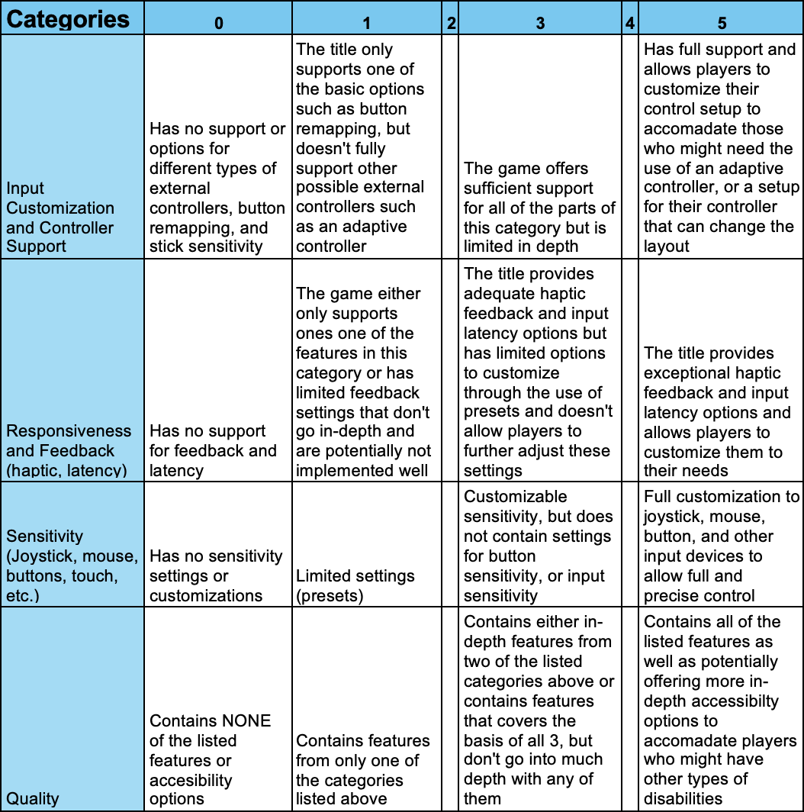
Research + Structure of Rubric
What are some problems that gamers with disabilities face when playing a game?
Input customization and Controller Support
  Helpful for people with motor impairments or the loss of a limb who might not be able to use the default control scheme.
Responsiveness and Feedback
  Helpful for people who may have a slower reaction times or slower motor functions
Sensitivity
  Helpful for people with limited mobility
Notes:
Make sure to talk about the quality category

Slide 7
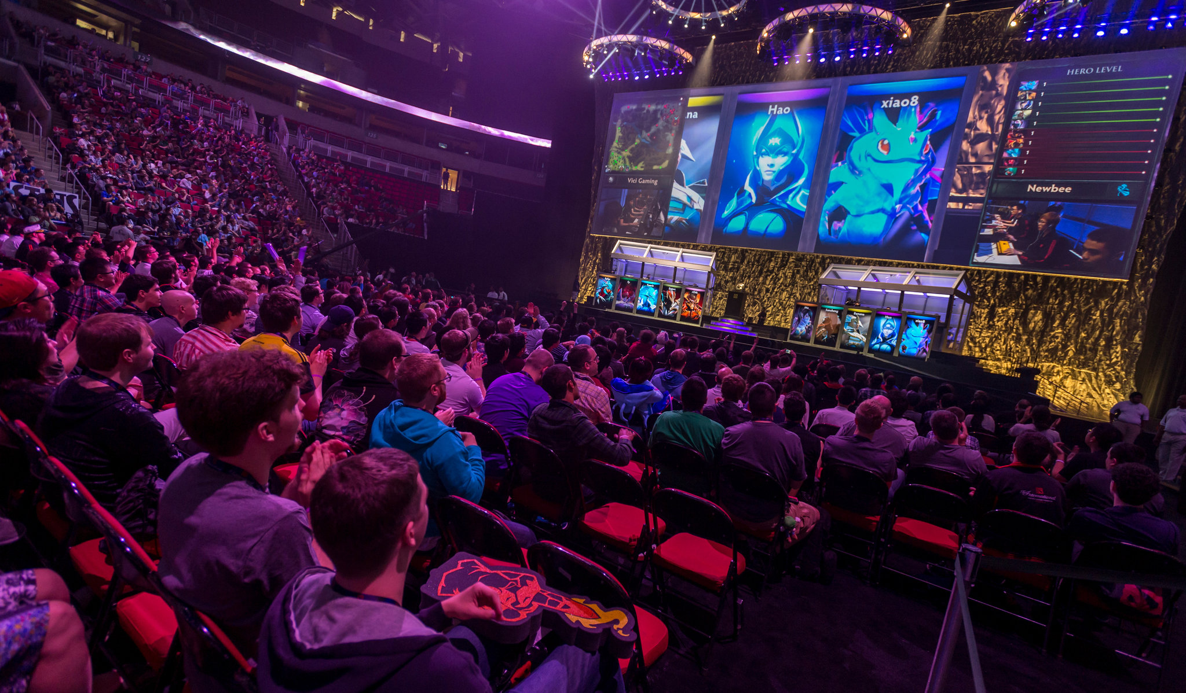
Process of games we picked
We listed the most popular games based on community size and viewership on different social media platforms
We then picked 15 that range different platforms and consoles (PC, Console, Mobile)
Graded them based off the rubric we created

Slide 8
Data Analysis

Slide 9
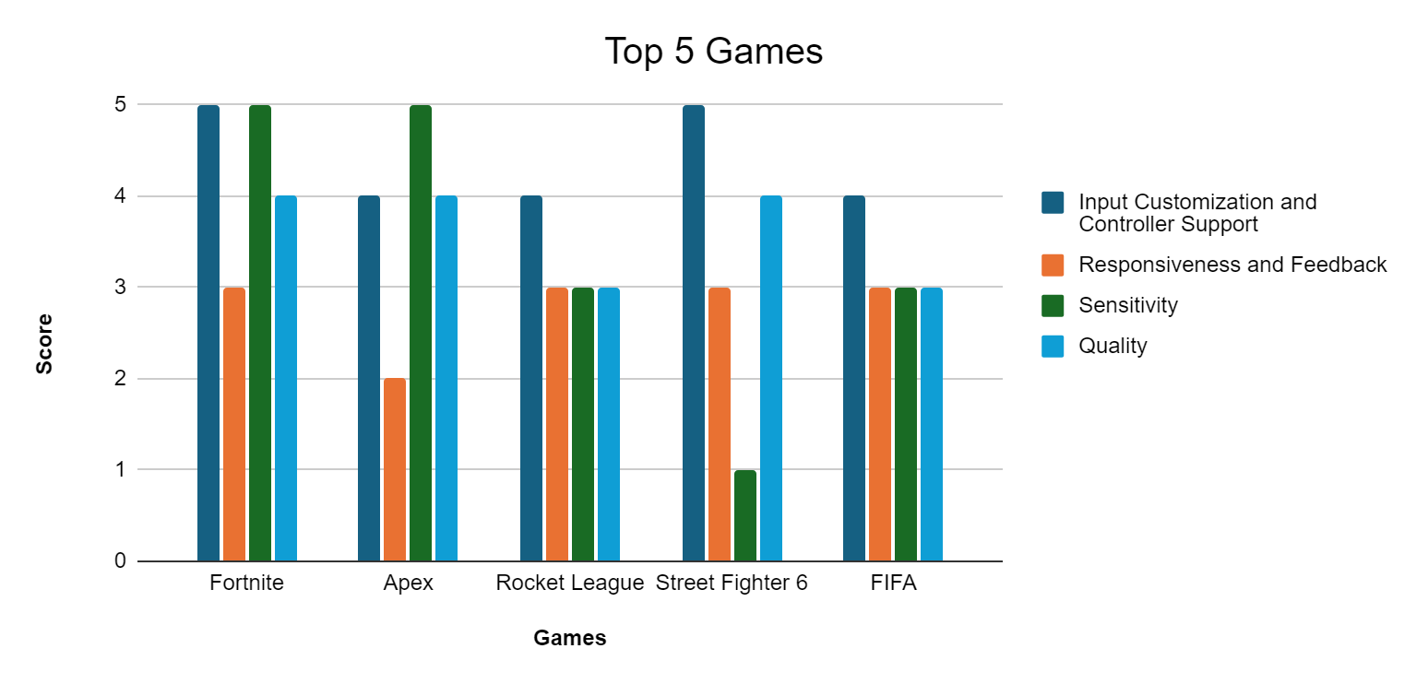

Slide 10
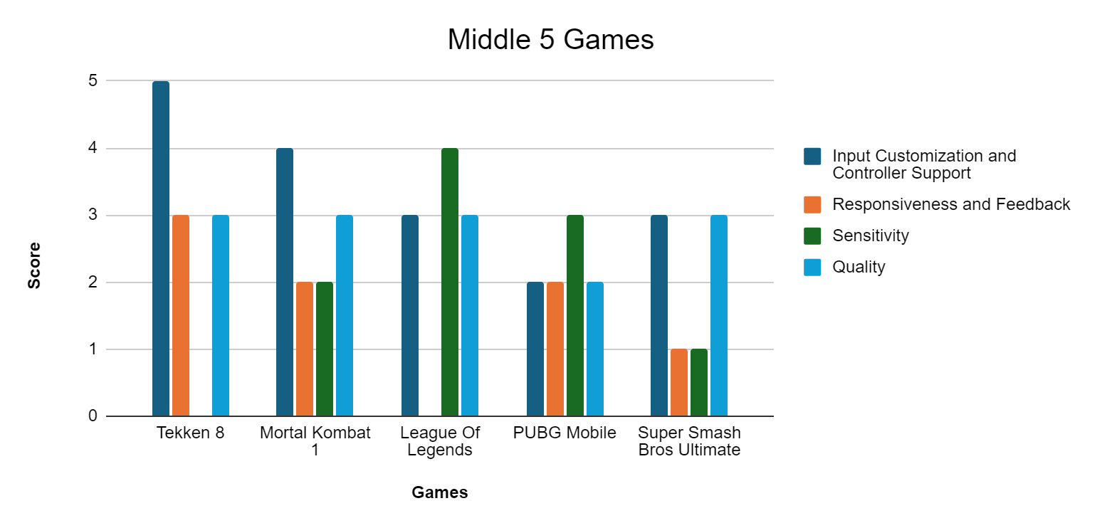

Slide 11
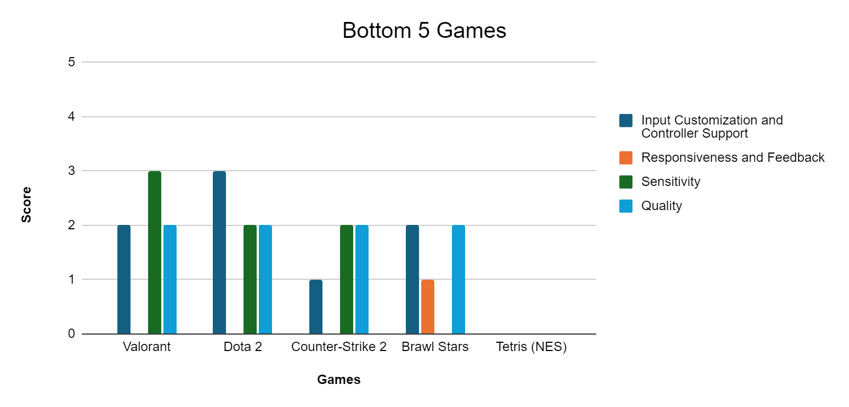

Slide 12



Game Choices for Ethnography
We decided to look at a game from each of the 3 groups to see the impact that these features might have on a title’s eSports community
Looked through various different community hubs to see what players said about the game’s features and how it affected them
Also looked to see if the community does anything to be inclusive and accommodate those with disabilities

Slide 13
Community
Ethnography

Slide 14
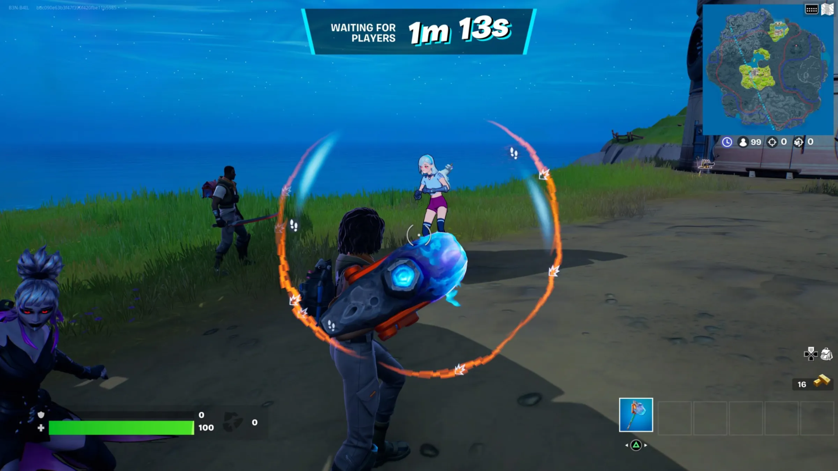
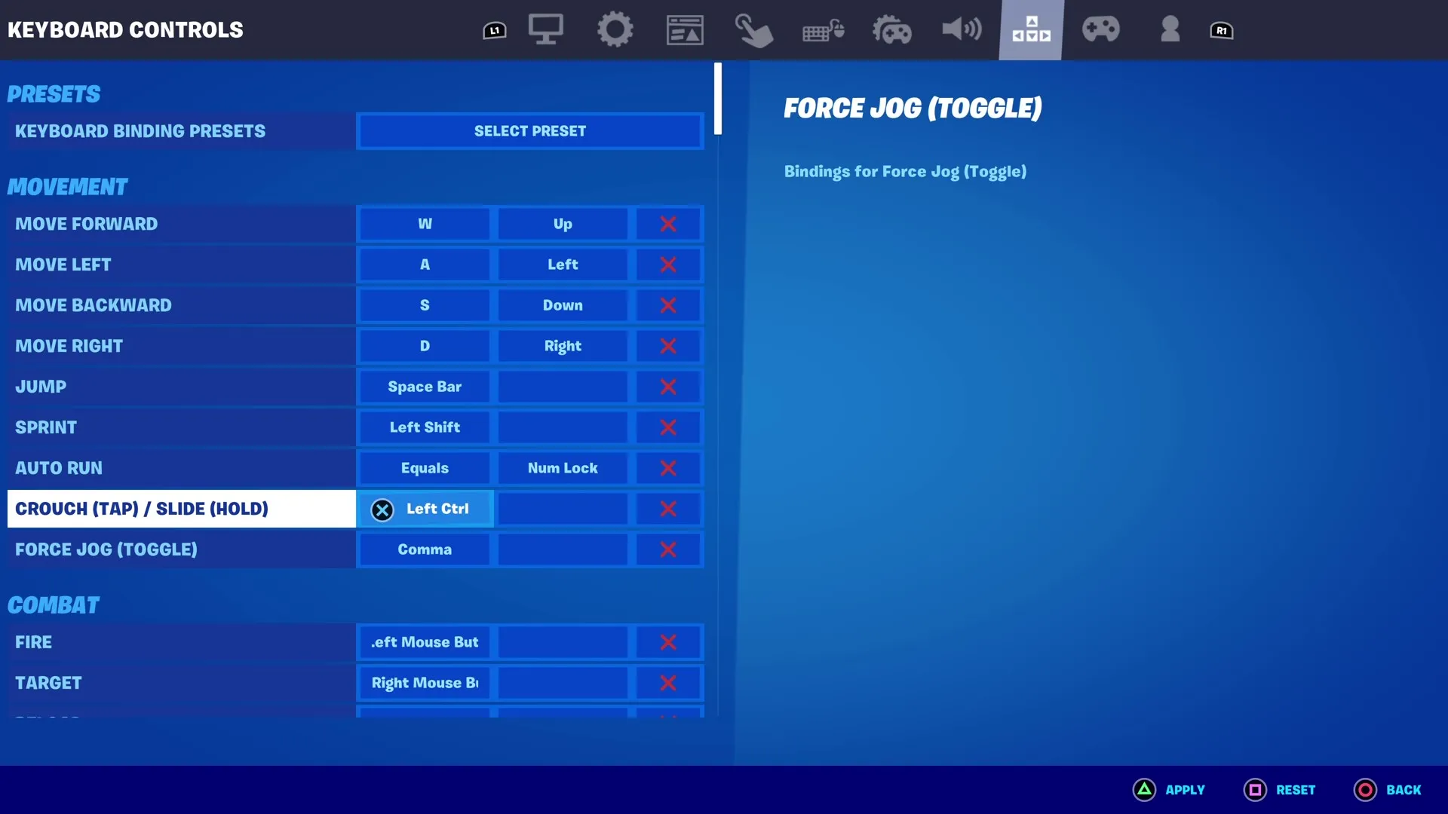
Fortnite
Data Collection Methods:
Participant Observation.
Developer Interaction and Responsiveness:
Epic Games was highly responsive to accessibility feedback provided through their official channels. They regularly featured community feedback in patch notes and update logs.
Use and Impact of Accessibility Features:
Remapping for controller and keyboard (Presets Option)
Assistive modes like auto run,auto open doors, auto aim.
Sound visualization wheel
HUD scaling
Game modes for a variety of play styles

Slide 15
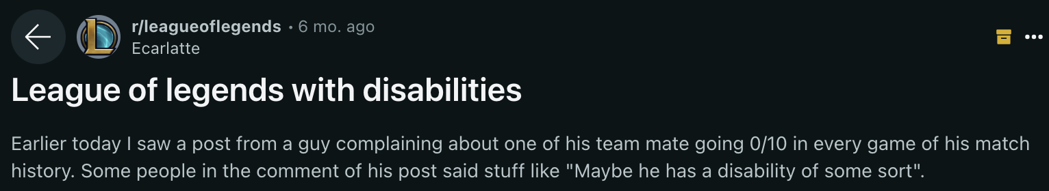
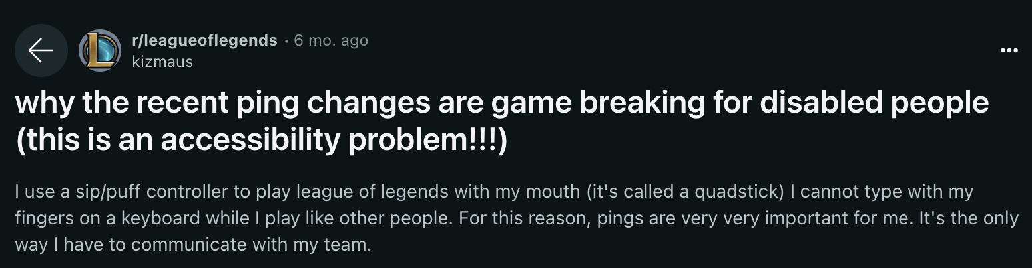

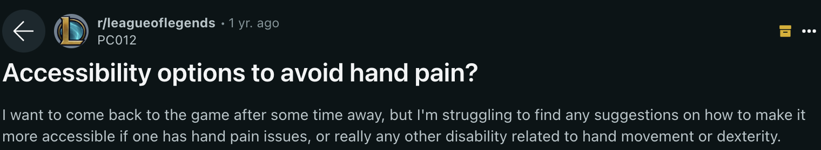
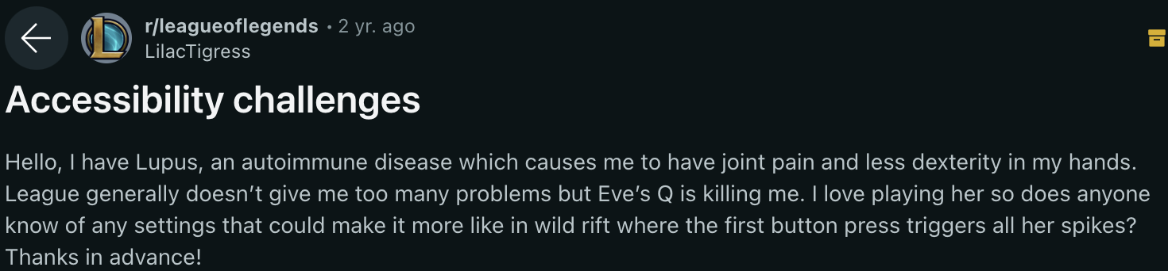
League of Legends
Many players were complaining about the lack of accessibility
Players also pointed out how the developers removed some accessibility features
Players need to use creative workarounds while skirting through the guidelines.
The community does not seem to accommodate people with disabilities much.
Notes:
After reading through the League of Legends subreddit, you would expect a triple A company such as Riot Games to have great support for accessibility.

Slide 16
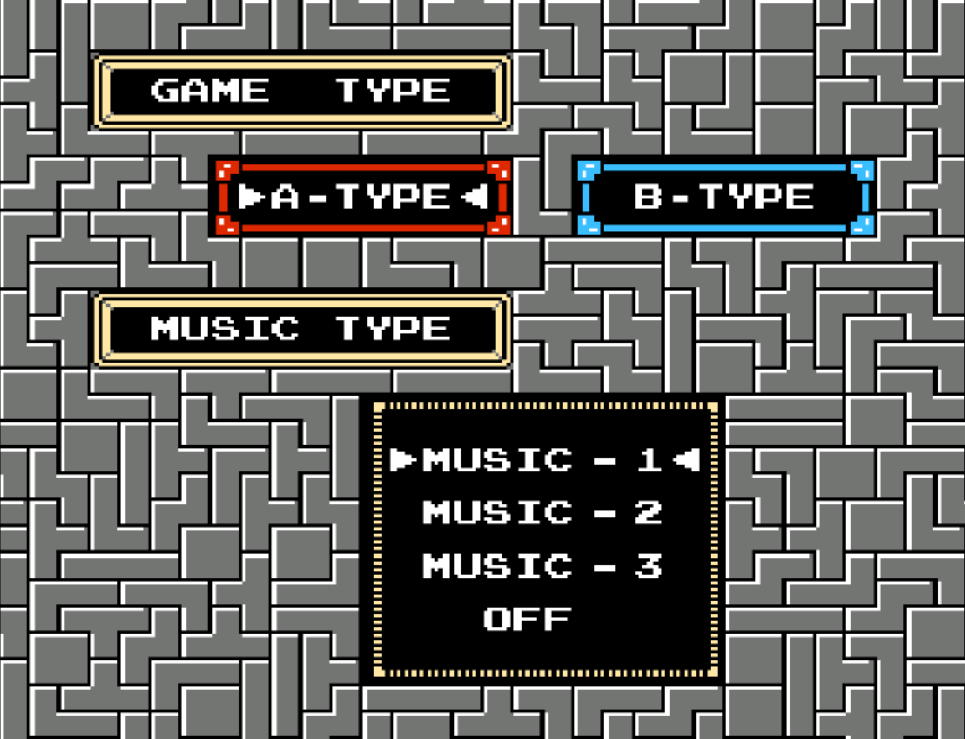
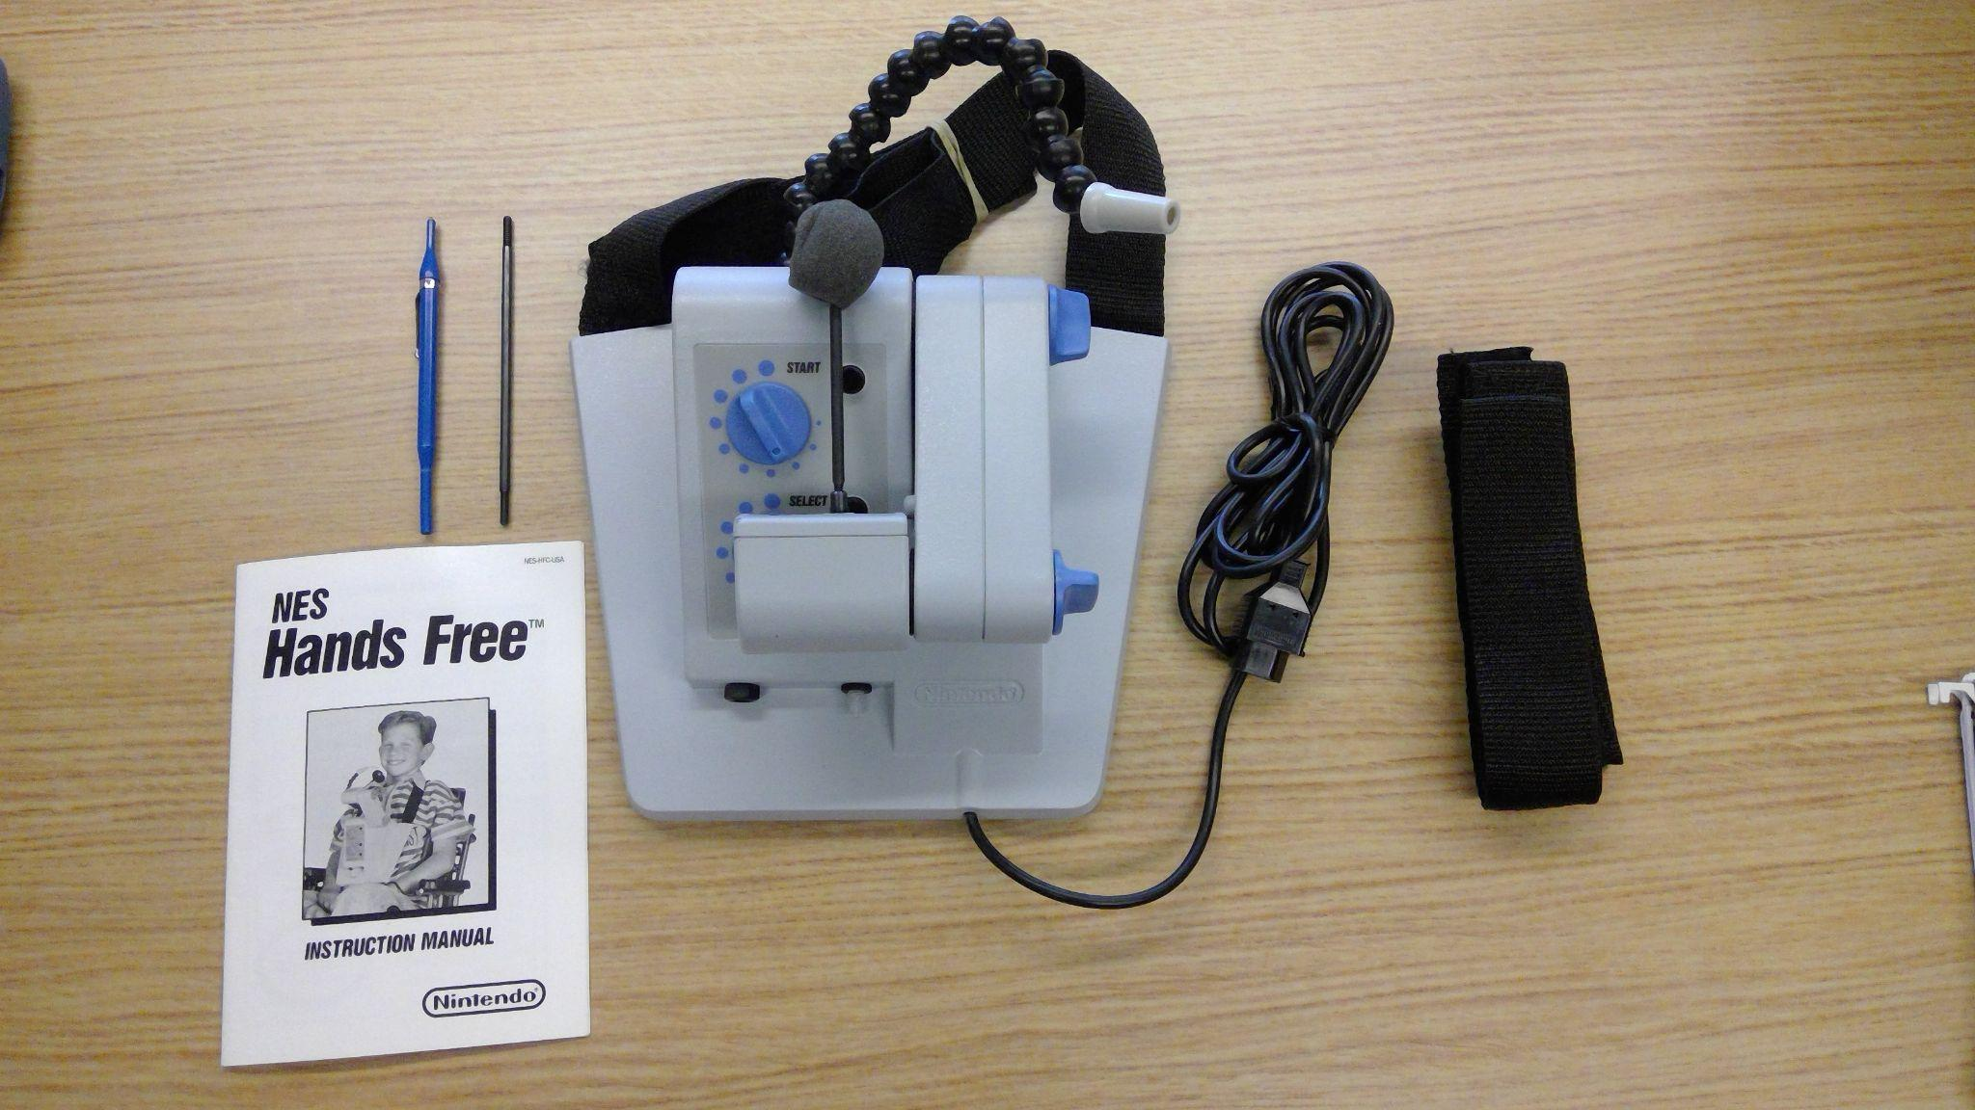
Tetris (NES)
Game has no settings page or menus
Due to the lack of accessibility in the game, the community has rules to aid those who need it
Official CTWC ruleset allows for players to bring and use their own controller provided it works with the NES system
NES Hands-Free Controller
Community itself is extremely supportive and accommodating to everyone in it

Slide 17
Conclusion
How can eSports titles improve accessibility?
  When in development, work with people with different types of disabilities for input with accessibility features and options
  Once the game launches, be receptive to feedback from players
  Reach out to the community to see what players need with accessibility
What can communities do to be more accommodating to players with disabilities?
  Rulesets
  Tournament Organizers, Casters, Officials, etc.
  Being more empathetic
Notes:
As seen by Fortnite, game developers must be receptive to feedback and involved in the community to ensure better accessibility

Slide 18

Thank You !

Slide 19
Sources for Slides
"Why Gaming Is Not Just a Hobby but a Lifeline for Millions of Gamers." Sky News, [2 September 2023], https://news.sky.com/story/why-gaming-is-not-just-a-hobby-but-a-lifeline-for-millions-of-gamers-12952807.
Mission and Vision,” Sins Invalid, accessed April 14, 2022, https://www.sinsinvalid.org/about-us
“Ableism,” Merriam-Webster, accessed April 14, 2024, https://www.merriam-webster.com/dictionary/ableism

